Slide 1


Blinkit Sales Analysis
Operational Performance & Strategic Growth Insights 2022

Slide 2
Executive Performance Overview
Growth Trajectory
1.20M
The operational landscape shows strong fundamentals with over 9,000 items successfully delivered across all tiers. An average consumer rating of 3.92 indicates high satisfaction and service reliability.
TOTAL SALES REVENUE
9K Items Sold
3.92 Avg Rating

Slide 3
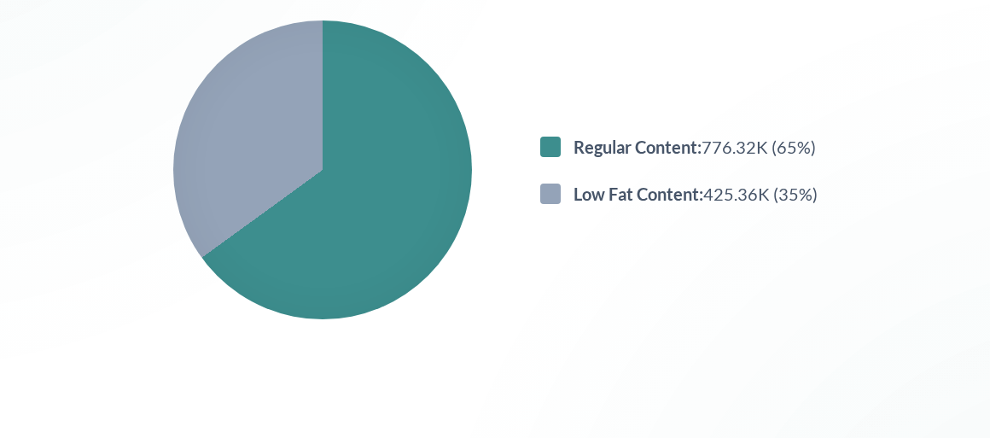
Consumer Preference: Fat Content
Market preference leans significantly toward regular fat products, which outperform low-fat variants across all three geographic outlet tiers.

Slide 4
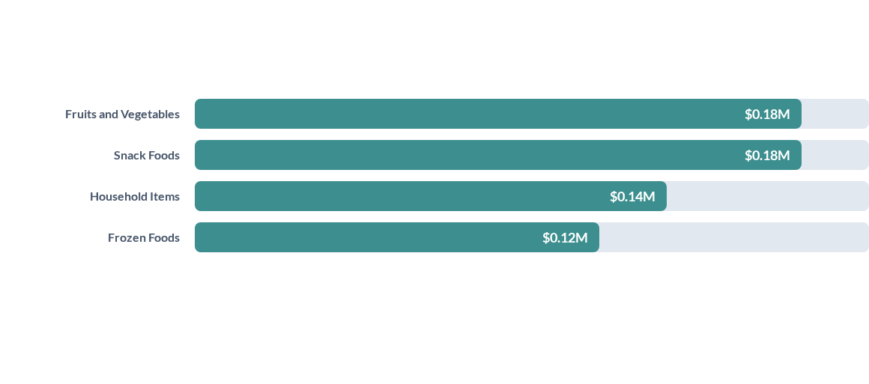
Top Performing Categories
Fresh produce and snack categories are the primary revenue drivers, tied for lead performance at 0.18M total sales each.

Slide 5
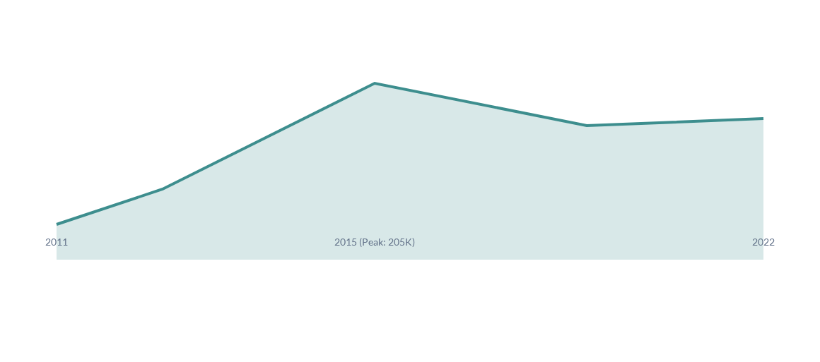
Outlet Establishment Timeline
Following a significant expansion peak in 2015 reaching 205K in establishment sales, the market has stabilized at a healthy 131K baseline by 2022.

Slide 6


Sales Impact by Outlet Size
Medium Outlets
Small & High Outlets
$507.9K
$444.8K
Dominant store format providing the ideal balance between inventory depth and operational efficiency.
Small formats remain highly competitive, nearly matching medium sales, while High-format stores contribute $249K.

Slide 7

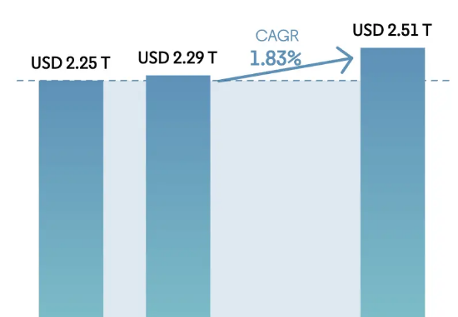
Geographic Sales Analysis
Tier-wise Performance
Geographic analysis reveals that Tier 3 locations lead with $472.13K in sales, indicating deep penetration into broader urban and suburban markets.
Tier 2 ($393K) and Tier 1 ($336K) follow, showing a healthy distribution across all urban density levels.

Slide 8
Outlet Type Comparison
Outlet Type | Avg Sales | Total Sales | Items Sold | Avg Rating
Supermarket Type 1 | $141.21 | $787,549 | 5,577 | 3.92
Grocery Store | $140.29 | $151,939 | 1,083 | 3.93
Supermarket Type 2 | $141.68 | $131,477 | 928 | 3.93
Supermarket Type 3 | $139.80 | $130,714 | 935 | 3.91

